Slide 1
Nutrition & Athletic Preparation in Roundnet
Kevin Sauer

Slide 2
About Me
01 Introduction
playing Roundnet since 2023
working with the german national team since start of 2024
previously worked in football and figure skating as an S&C Coach

Slide 3
Learn how to …
01 Introduction
estimate RMR and total energy needs during a tournament day
calculate fluid needs during a tournament day
plan food and fluid timing troughout the day
Adjust your gym routine for roundnet performance
Notes:
You will ned a calculator and something to write.

Slide 4
Energy balance: the simplest model is still useful
02 Energy Balance
Energy balance = Energy intake − Total energy expenditure
INTAKE
EXPENDITURE
OUTCOME
meals
snacks
fluids
sports foods
−
RMR
TEF
NEAT
Exercise
=
maintenance
gain/loss
fuel availability
Game-day lens
A tournament is too short for meaningful body-composition change, but long enough for low carbohydrate and fluid availability to affect repeated sprint, jumping, decision-making, and technical execution.
Sources:[1-3,6]

Slide 5
Total energy expenditure has four practical pieces
02 Energy Balance
RMR
TEF
NEAT
EAT
Resting metabolic rate
Thermic effect of food
Non-exercise activity thermogenesis
Exercise activity thermogenesis
largest baseline cost; organs + lean mass
usually ~small slice; rises with meals
walking, coaching, setting up nets
warm-ups + match play
Sources:[1,3,4,11]

Slide 6
Calculating RMR – different Methods
03 Calculating RMR
Best data
Equation
Use case
FFM available
Cunningham: RMR = 500 + 22 × FFM(kg)
Often practical for trained adults with reliable body-composition data
No Data Available
Harris–Benedict for M: 66.47 + 13.75W + 5H - 6.76A
Harris-Benedict for F: 655.1 + 9.56W + 1.85h – 4.68A
Okay for screening, but may under/over-estimate some athlete groups
W=weight in kg. H=height in cm. A=age in years. All outputs are kcal/day
Sources:[4,5]

Slide 7
Working example: 75 kg athlete at 15% body fat
03 Calculating RMR
Step 1
Step 2
Step 3
Fat-free mass
Cunningham RMR
Use a range
FFM = 75 × (1 − 0.15)
FFM = 63.8 kg
RMR = 500 + 22 × 63.8
RMR ≈ 1,900 kcal/day
Planning range:
~1,700–2,100 kcal/day
before activity
Coachable point
precise-looking RMR number should not create false precision. Build the plan, then adjust from repeated observations.
Sources:[4,5]

Slide 8
Going from RMR to TEE
04 Calculating TEE
RMR
Daily movement
Warm-ups
Match play
TEF
baseline metabolism
walking, setup, standing
mobility + general + sport specific
groups + bracket
food processing
+
+
+
+
~1,900 kcal
~8–12% intake
Sources:[1,3,10,11]

Slide 9
Using METs to calculate TEE
04 Calculating TEE
kcal/min = MET × 3.5 × body mass(kg) ÷ 200
1–2 MET
3–4 MET
5–7 MET
8+ MET
rest / standing
walking / light warm-up
moderate-vigorous intermittent play
hard repeated sprint phases
Sources:[10,11]
Notes:
METS =Metabolic Equivalent of Task

Slide 10
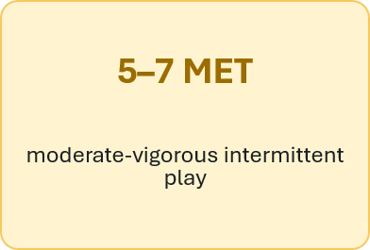
What MET to use for Roundnet?
04 Calculating TEE
Average HR
133.6 ± 9.4 bpm
~70% HRmax
Maximum HR
159.7 ± 7.9 bpm
~84% HRmax
Lactate
1.2 ± 0.2 mmol/L
low average glycolytic stress
Set duration
≈ 15min
short, repeatable bouts
Steps/min
73.1 ± 11.6
continuous repositioning
Sources:[9,10]

Slide 11
Working example: 75kg athlete
04 Calculating TEE
Block
Assumption
Calculation
kcal
Match play
14*15min = 210min @ 6 MET
(6-1) × 3.5 × 75 ÷ 200 × 210
1378
Warm-ups
45 min @ 4 MET
(4-1) × 3.5 × 75 ÷ 200 × 45
177
Walking/standing
240 min @ 1.6 MET
(1.6-1) × 3.5 × 75 ÷ 200 × 240
189
Baseline RMR
day baseline
~1,900 × tournament-day fraction
~1700–2100
Result: roughly 3500 – 3900 kcal for the day. Adding 10% TEF means a total of roughly 4000 kcal.
Sources:[1,4,9-11]
Notes:
Also Study by Lukas Lemberger exists with 150 kcal per set for women and 250kcal for men per set = 14*150 = 2100 …
15minutes because most recent bachelorthesis found roughly 15 minutes of average duration for a set for womens games in Bundesliga. Could be different for games to 17 or 21 aswell as for Mix or Open

Slide 12
Fueling your Body
05 How to Fuel
Carbohydrates
Carbs are our main source of energy during activity. Make sure to eat enough carbs the day before a tournament and during breaks on tournament day.
Protein
Fat
Aim for regular protein doses across the day; a post-tournament meal or snack supports repair and satiety.
Needed for health and energy, but large high-fat meals close to play can slow gastric emptying and feel heavy.
Sources:[1-3]
Notes:
Simple carbohydrates
Broken down quickly
Give the body fast energy
Found in sugar, sweets, soft drinks, fruit and milk
Highly processed sugary foods can cause quicker rises and falls in blood sugar
Complex carbohydrates
Usually take longer to digest
Can provide more steady, longer-lasting energy
Often contain more fiber, vitamins and minerals
Found in oats, whole grains, beans, lentils, potatoes and vegetables
Good to know:
“Simple” does not always mean unhealthy and “complex” does not always mean healthy. The amount of fiber and how processed the food is also matter.

Slide 13
Carbohydrates
06 Carbohydrates
Timing
Target
Roundnet translation
Day before / high-load blocks
~5–7 g/kg/day for moderate-to-heavy training; more if very high volume
normal meals with carbohydrate at every meal
1–4 h before
~1–4 g/kg depending on time and tolerance
breakfast/lunch: rice, oats, bread, fruit, low-fiber options
During long brakes
~30–60 g/h when repeated play exceeds ~60–90 min
sports drink, banana, chews, gels, rice cakes, pretzels
Over the tournament day
65% Carbs of total kcal
meal within 1–2 h; snack sooner if appetite is low
Sources[1-3,12]

Slide 14
Do not edit
How to change the design
Name your favorite Snack (in gr) with ~20gr of carbs
The Slido app must be installed on every computer you’re presenting from

Slide 15
Do not edit
How to change the design
Name your favorite Snack (in gr) with ~40gr of carbs
The Slido app must be installed on every computer you’re presenting from

Slide 16
Fueling timeline – don‘t mess up before the first serve
07 A possible Timeline
24 h before
1–4 h before
30–60 min
Between matches
After final
1
2
3
4
5
normal high-carb meals + salt
meal: 1–4 g/kg carbs + moderate protein
top-up snack if hungry or first match delayed
sip fluids + 20–40 g carbohydrate as needed
meal/snack + rehydrate by sweat losses
Practice rule
Nothing new on tournament day: trial foods, fluids, caffeine, and sodium in training or lower-stakes play.
Sources:[1-3,7]

Slide 17
Match your snack to the break length
08 between games
Break length
Fueling move
Examples
<15 min
fluid + quick carbohydrate
sports drink, gel, chews, banana bites
15–45 min
carb snack + electrolytes
banana + pretzels; rice cakes + jam; sports drink
45–90 min
mini-meal
Pasta, sandwich/wrap, rice bowl, yogurt + granola
>90 min
meal + normal fluids
balanced meal; keep fats/fiber moderate if next match is intense
Sources:[1-3,12]

Slide 18
macro split
TOTAL
CARBS
PROTEIN
FAT
~4,000 kcal
657g
154 g
86 g
65% C
15% P
20% F
Block
Food
Macro total
Timing note
Breakfast
Bagels 150 g • jam 42 g • banana 125 g • 0% Greek yogurt 165 g • peanut butter 21 g • honey 17 g • butter 3 g
~927 kcal
C156 / P39 / F17
3–4h pre-first game
Snack 1
Sports drink 415 ml • banana 110 g
~206 kcal
C50 / P1 / F0
30–60min pre-game
Snack 2
Rice cakes 25 g • honey 17 g • sports drink 275 ml
~212 kcal
C50 / P2 / F1
20–45min gap
Lunch
Cooked pasta 333 g • soy mince/TVP 25 g • tomato passata 167 g • olive oil 15 g • white bread 67 g
~991 kcal
C157/ P40 / F23
Longest break; ideal 90+min before next game
Snack 3
White bread 50 g • jam 30 g • lean turkey slices 33 g
~261 kcal
C45 / P15 / F2,5
45–90min gap
Snack 4
Low-fat chocolate milk 415 ml • banana 85 g • honey 17 g
~416 kcal
C74 / P15 / F7
Final games or immediate recovery
Dinner
Cooked pasta 291 g • chicken 42 g • tomato sauce 167 g • parmesan 17 g • olive oil 23 g • white bread 42 g
~986 kcal
C125 / P42 / F36
Post-tournament recovery

Slide 19
Do not edit
How to change the design
Did you eat enough at past events?
The Slido app must be installed on every computer you’re presenting from

Slide 20
Underhydrating
09 Hydration
During Day 1
Into Day 2
Hypohydration raises cardiovascular and thermal strain and perceived effort. Cognitive performance is more consistently impaired once body-mass loss exceeds ~2%.
If post-match rehydration is incomplete, the athlete can begin the next day with a deficit. Replacing fluid after dehydration can improve subsequent exercise, especially in heat.
Sources:[7,8,17-19]
Notes:
Hypohydration is the state of having an abnormal deficit of body water, typically defined as a loss of more than 2% of body mass. While dehydration is the active process of losing water, hypohydration is the resulting static condition or outcome of that water loss. [

Slide 21
Calculating Sweat Rate
09 Hydration
Sweat rate (L/h) = [pre mass − post mass + fluid intake − urine] ÷ time(h)
Example
Pre 75.0 kg → Post 74.2 kg | Drank 0.6 L | Urine 0 L | Time 1.5 h
Sweat loss = 0.8 + 0.6 = 1.4 L Sweat rate = 1.4 ÷ 1.5 = 0.93 L/h
Use it practically
Plan to replace a meaningful share of sweat losses while avoiding body mass gain. Repeat tests in heat, shade, different surfaces, and high/low match density.
Sources:[7,8]

Slide 22
Eloctrolytes
09 Hydration
Practical tool: use salty foods + sports drink/electrolytes when sweat rate and heat make water alone insufficient.
Higher need
Lower need
heat, long day, heavy sweater, salty residue, high sweat rate
cool conditions, short sessions, low sweat rate, normal meals
Sourches:[7,8]

Slide 23
We are all different
10 Application
Heavy sweater
prioritize sweat-rate testing, shade, sodium, and cooling
Low appetite
liquid carbs, smoothies, small frequent snacks
History of low energy availability
do not use aggressive deficits around tournaments
Sensitive gut
lower fiber/fat pre-match and simplify choices

Slide 24
Key Messages
11 Nutrition Summary
1
Start full: breakfast and hydration matter before the first match.
2
Estimate energy needs : RMR + TEF + NEAT + EAT
3
Carbs and fluids work best as steady inputs; Day 1 recovery is part of Day 2 performance.
4
Sweat-rate testing beats guesswork for hydration.
5
Individualize: the best plan is evidence-based and athlete-tested.
Sources:[All]

Slide 25
Athletic Preparation for Roundnet
12 S&C
Short Term
Long Term
Sleep
Nutrition
Warm Up’s
Etc.
Strength Training
Conditioning
etc.

Slide 26
Benefits of Strength and Conditoning
12 S&C
Faster, more explosive
Improved Endurance
Less Injuries
Better energy efficency through movement economy

Slide 27
Considerations for Roundnet
13 Considerations
Stop and go Nature → Short distances and short durations → Accelaration and Deceleration
High Amount of lateral Movement → Recieve
Ankle, Shoulder and Elbow commonly injured
High amount of spinal rotation when hitting/serving
Uniqe Structure becausfe of tournament days

Slide 28
Consequences for Strength Training
14 Consequences
Focus maximum strength for „games“ → 1-5 reps @ 80-90% of 1RM
Focus muscular endurance for tournaments → >15 reps
Focus mainlifts and add accessoires based on injury history or commonly injured structures
Incorporate lateral force production, rotational movements, ballistic excercises and Jumps in the gym

Slide 29
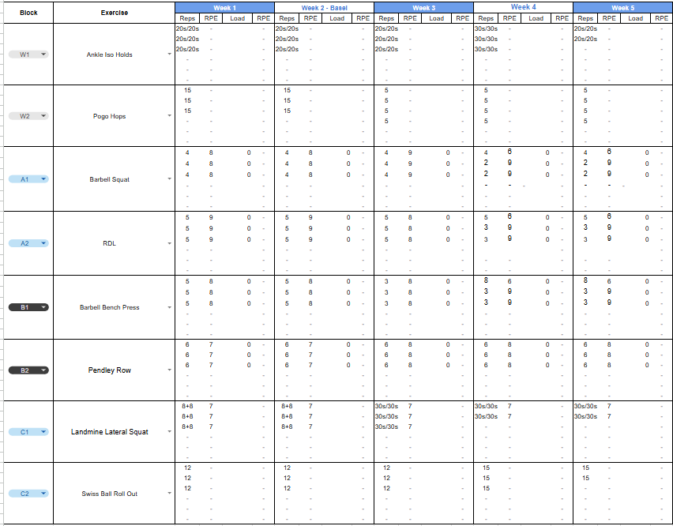
Example Workout

Slide 30
Consequences for Conditoning
14 Consequences
Long runs >60min should be at an easy pace to build endurance for tournament days
Intervalls can be made roundnet specific by slighlty overloading an average rally duration and using typical distances → rally duration roughly 5s on average
Sources [20]

Slide 31
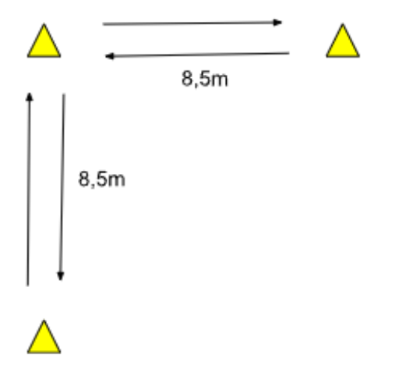
Example Conditoning Session
Week 1 | Week 2 | Week 3 | Week 4
3 Sets of 8 times 4x 8,5m in 10s with 30s Pause 2x 90 °cut 1x 180° Cut - 3 min Pause between Sets | 4 Sets of 8 times 4x 8,5m in 10s with 30s Pause 2x 90 °cut 1x 180° Cut - 3 min Pause between Sets | 4 Sets of 8 times 4x 10m in 12s with 36s Pause 2x 90 °cut 1x 180° Cut - 3 min Pause between Sets | 4 Sets of 8 times 4x 10m in 10s with 30s Pause 2x 90 °cut 1x 180° Cut - 3 min Pause between Sets

Slide 32
Sources
Thomas DT, Erdman KA, Burke LM. Nutrition and Athletic Performance. Med Sci Sports Exerc / J Acad Nutr Diet. 2016
Kerksick CM et al. ISSN Position Stand: Nutrient Timing. J Int Soc Sports Nutr. 2017.
Kerksick CM et al. ISSN Exercise & Sports Nutrition Review Update. J Int Soc Sports Nutr. 2018.
O’Neill JER, Corish CA, Horner K. Accuracy of RMR Prediction Equations in Athletes: Systematic Review with Meta-analysis. Sports Med. 2023.
ten Haaf T, Weijs PJM. Resting Energy Expenditure Prediction in Recreational Athletes. PLOS ONE. 2014.
Mountjoy M et al. 2023 IOC Consensus Statement on Relative Energy Deficiency in Sport (REDs). Br J Sports Med. 2023.
McDermott BP et al. NATA Position Statement: Fluid Replacement for the Physically Active. J Athl Train. 2017.
Sawka MN et al. ACSM Position Stand: Exercise and Fluid Replacement. Med Sci Sports Exerc. 2007.
Grimm N-O, Tomschi F. Investigation of exercise intensity in competitive roundnet/spikeball. IJPEFS. 2019.
Gallardo MPC et al. Physiological demands of racket sports: a systematic review. Biol Sport. 2023.
Herrmann SD et al. 2024 Adult Compendium of Physical Activities. J Sport Health Sci. 2024
Burke LM et al. International Association of Athletics Federations Consensus Statement 2019: Nutrition for Athletics. Int J Sport Nutr Exerc Metab. 2019.
Diaz-Lara J et al. Effects of Acute Caffeine Intake on Specific Performance in Intermittent Sports During Competition: Systematic Review and Meta-analysis. Int J Sports Physiol Perform. 2024.
Hartley C et al. Maltodextrin-Based Carbohydrate Oral Rinsing and Exercise Performance: Systematic Review and Meta-analysis. Sports Med. 2022.
Gallant TL et al. Low Energy Availability and Relative Energy Deficiency in Sport: A Systematic Review and Meta-analysis. Sports Med. 2025;55:325–339.
Craven J et al. Carbohydrate With and Without Protein on Muscle Glycogen Re-synthesis During Short-Term Recovery: Systematic Review and Meta-analysis. Sports Med Open. 2021;7:9.
Wittbrodt MT, Millard-Stafford M. Dehydration Impairs Cognitive Performance: A Meta-analysis. Med Sci Sports Exerc. 2018;50:2360–2368.
McCartney D, Desbrow B, Irwin C. Fluid Intake Following Dehydration and Subsequent Athletic/Cognitive Performance: Systematic Review and Meta-analysis. Sports Med Open. 2017;3:13.
Nuccio RP et al. Fluid Balance in Team Sport Athletes and Effects of Hypohydration on Cognitive, Technical, and Physical Performance. Sports Med. 2017;47:1951–1982
Müller MH. Auf dem Weg zu Olympia: Strukturanalyse von Roundnet in der 1. Damen Bundesliga. Bachelorarbeit im Fach Sportwissenschaft. Ruhr-Universität Bochum. 2026

